Slide 1
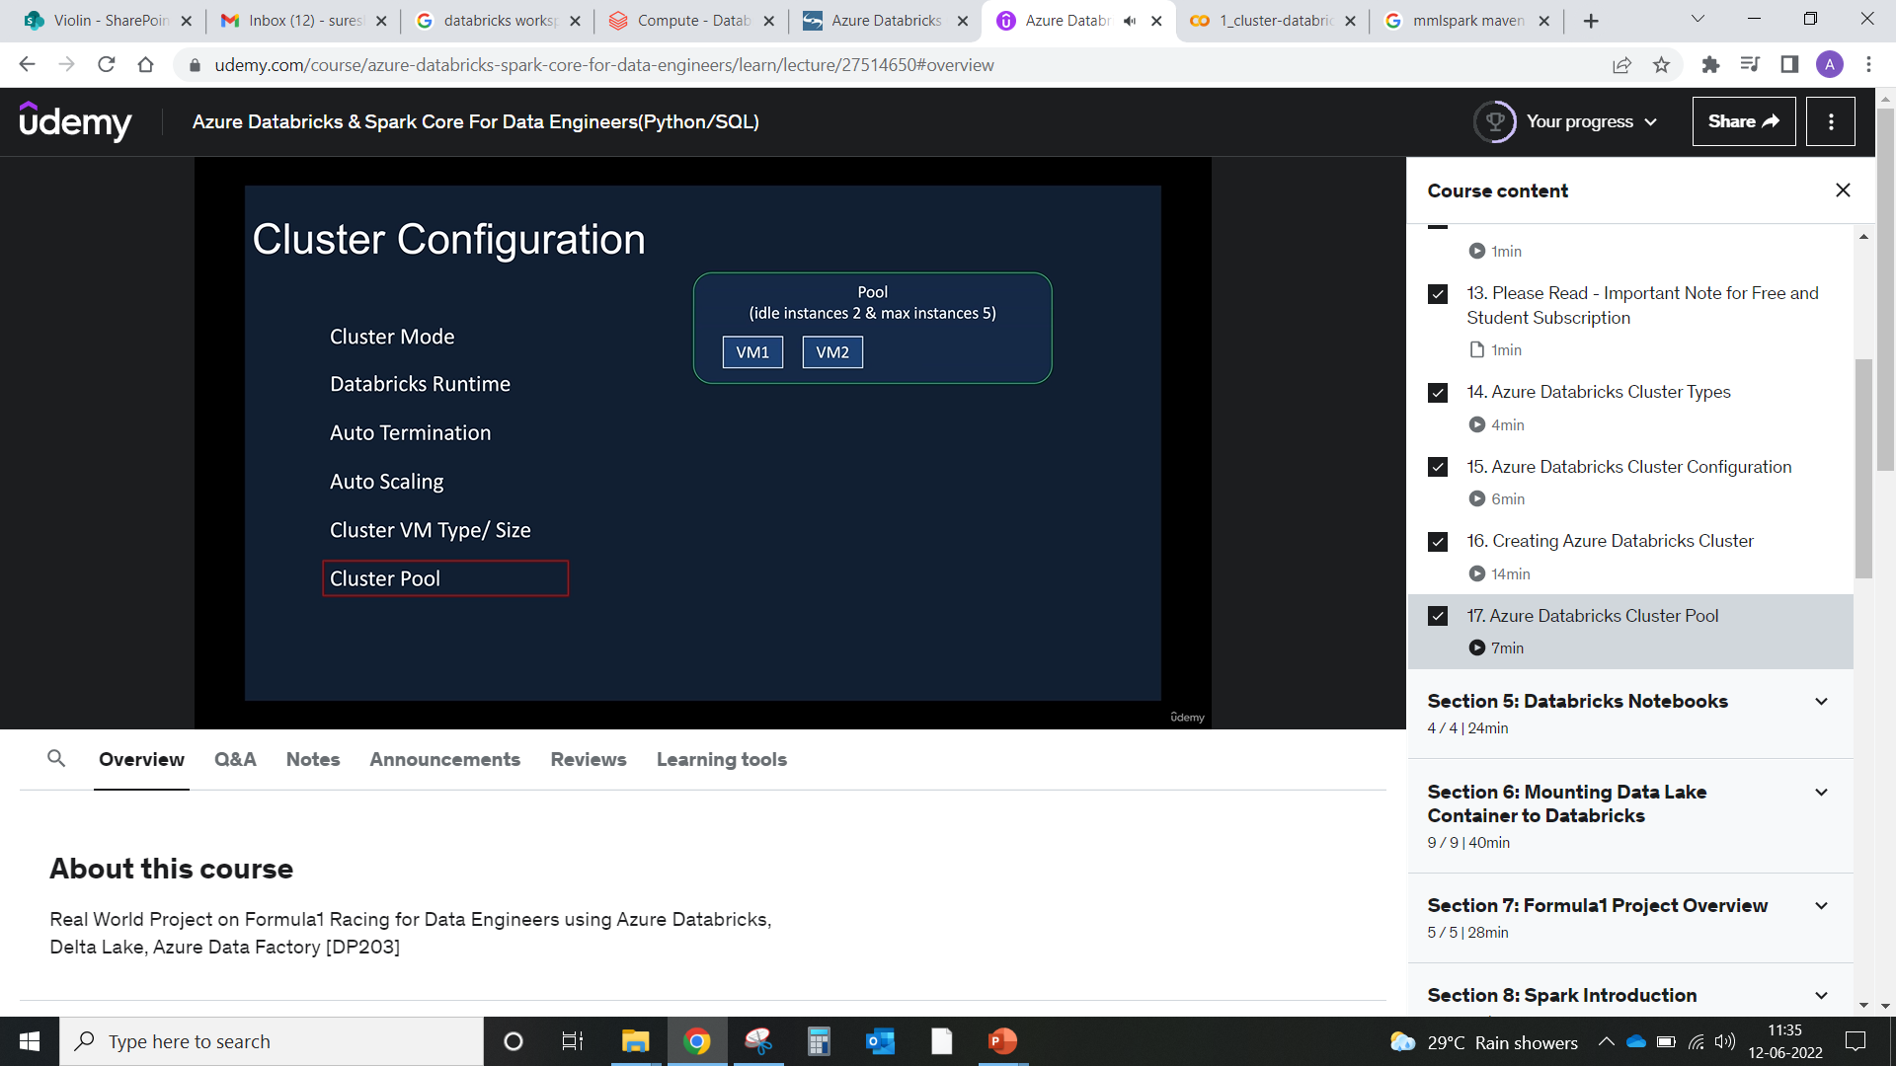
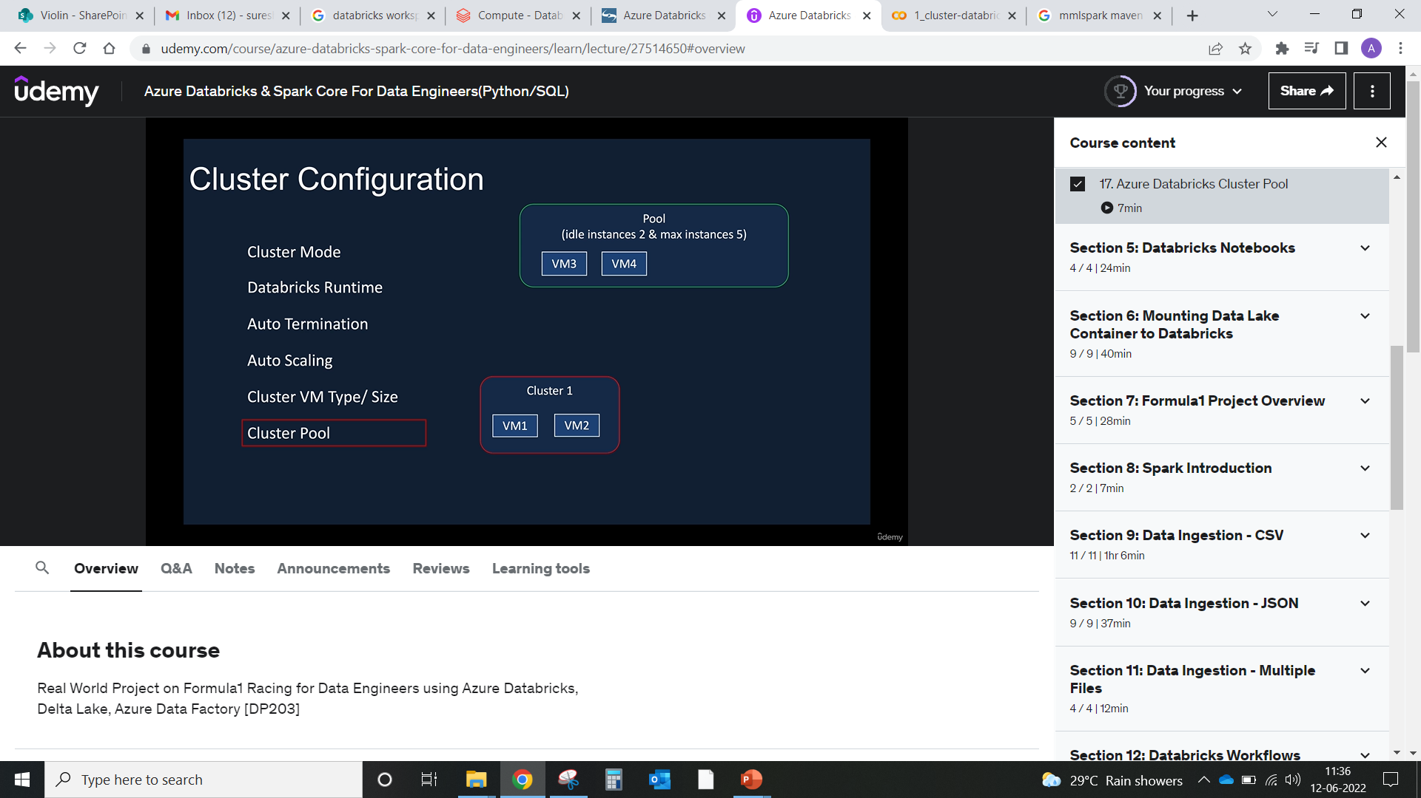
Cluster 1:
Requests for 2 nodes, the pool gives the 2 instances and spins up another 2 more instances ready.
Cluster 2:
a) Requests for 2 nodes then it can give 2 nodes which are ready (VM3 & VM4)
b) If cluster 2 request for 3 more nodes then it will give these 2 nodes which are VM3 & VM4 and also spin up
the new one which adds to the time.
c) If cluster 2 request for 4 more nodes then it will fail to start with the error that “there are not enough
instances to provide”.

Slide 2
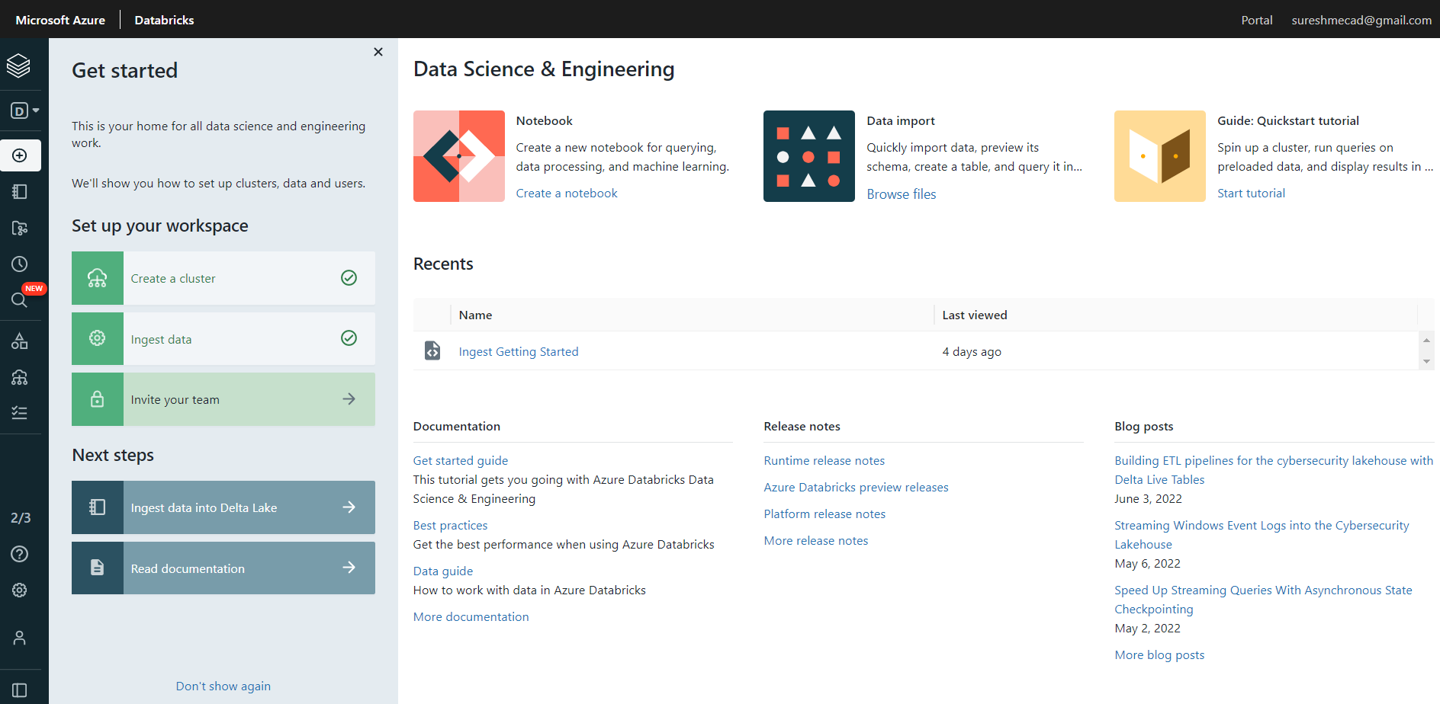

Slide 3
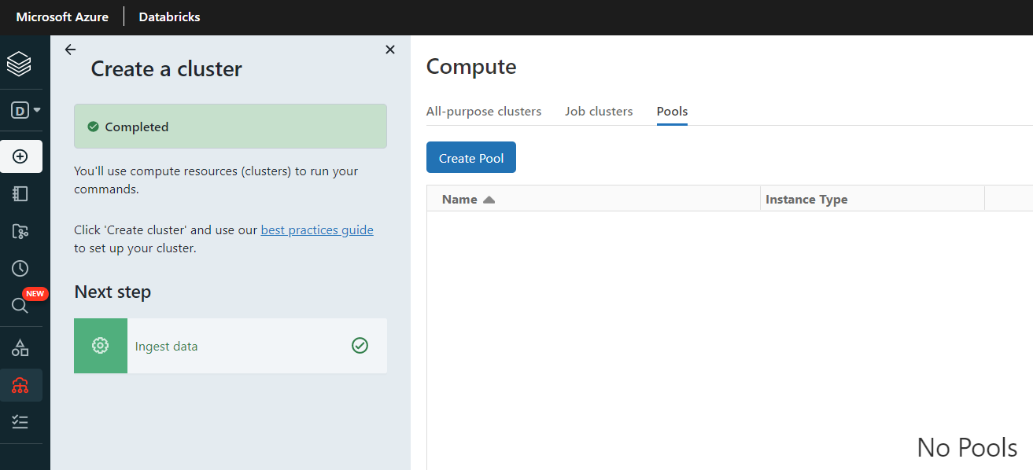

Slide 4
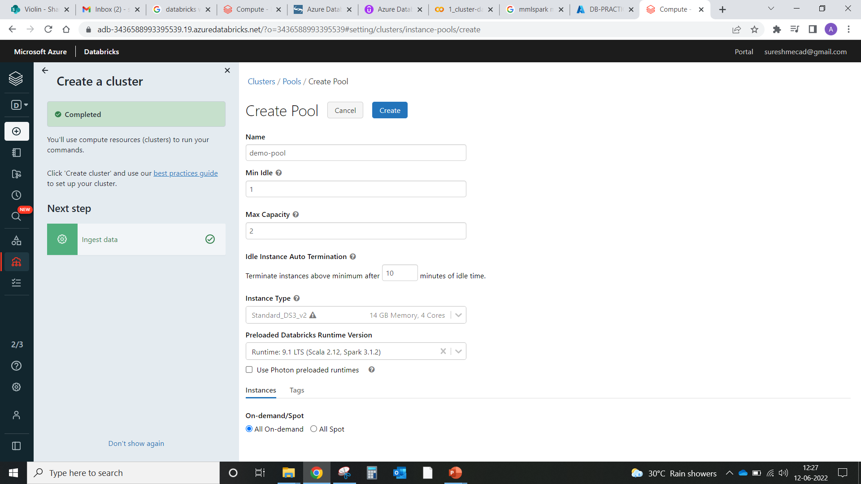
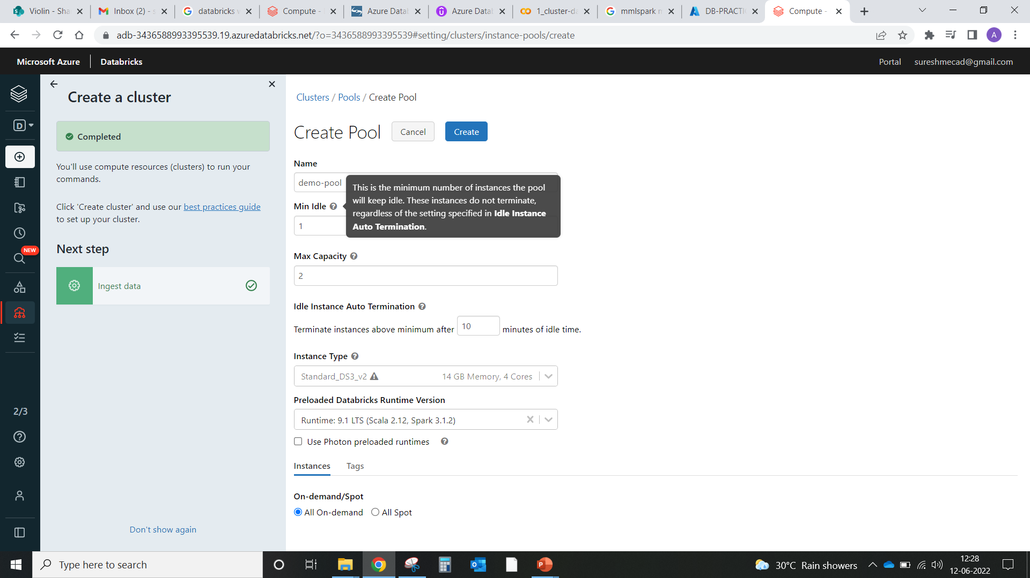
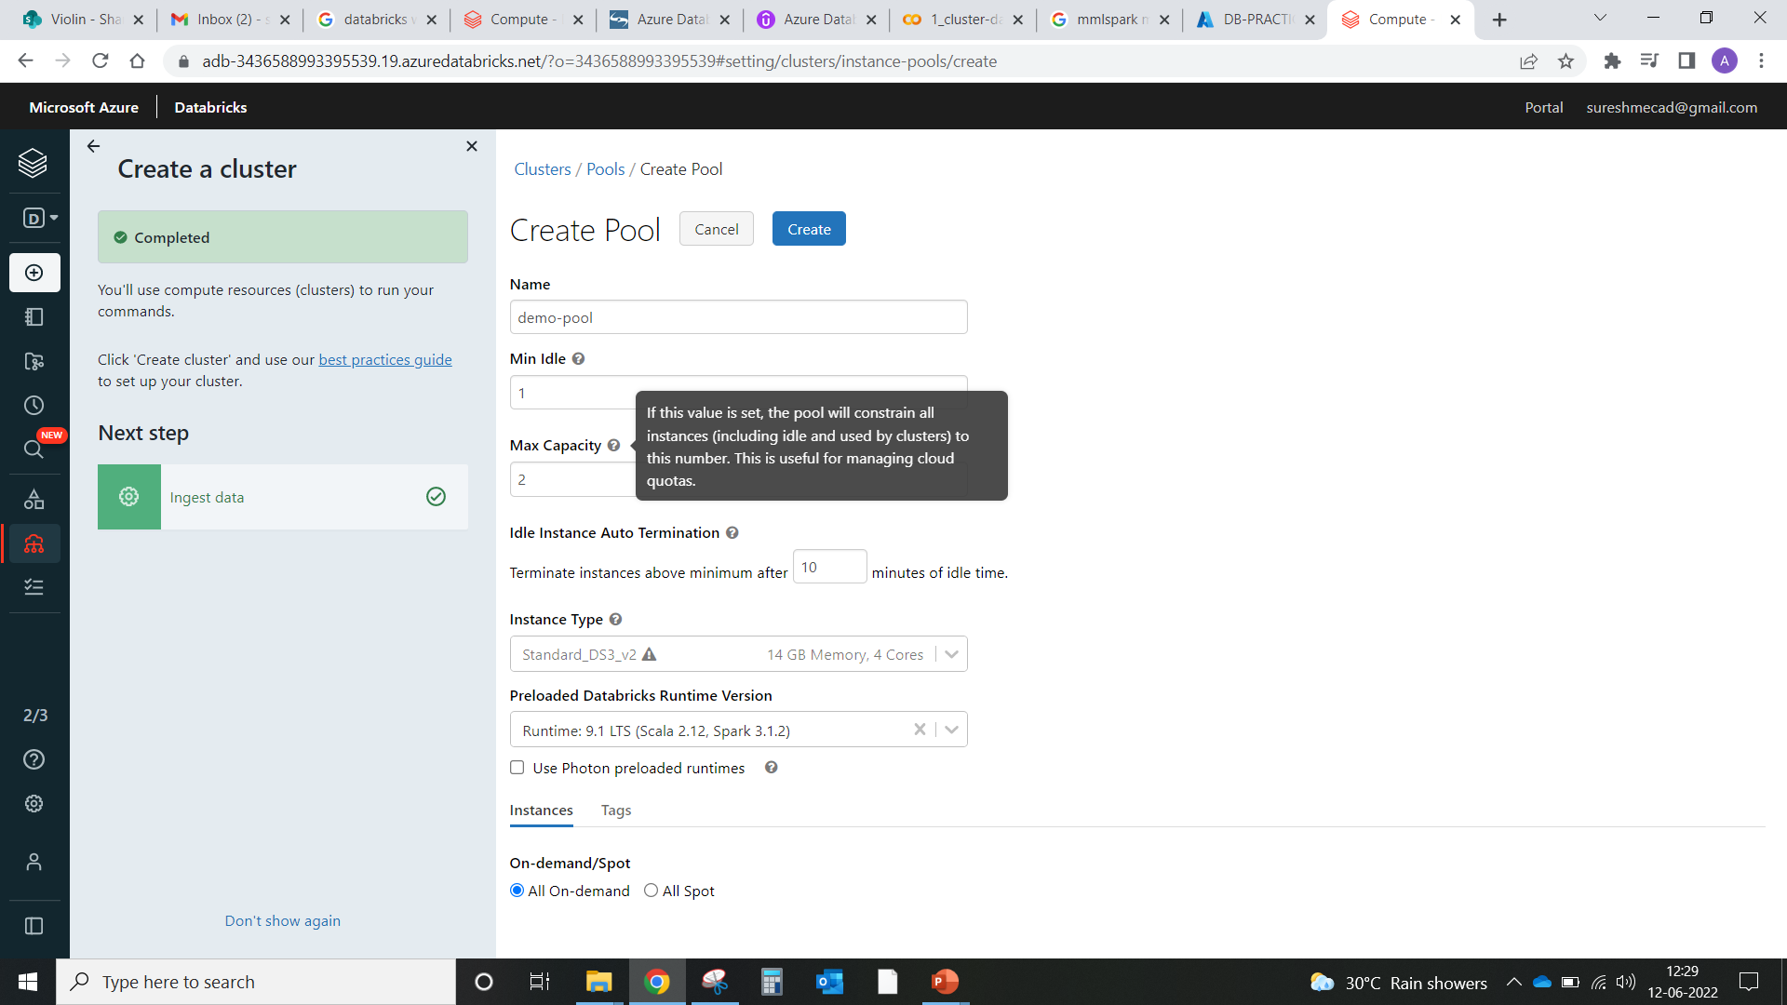
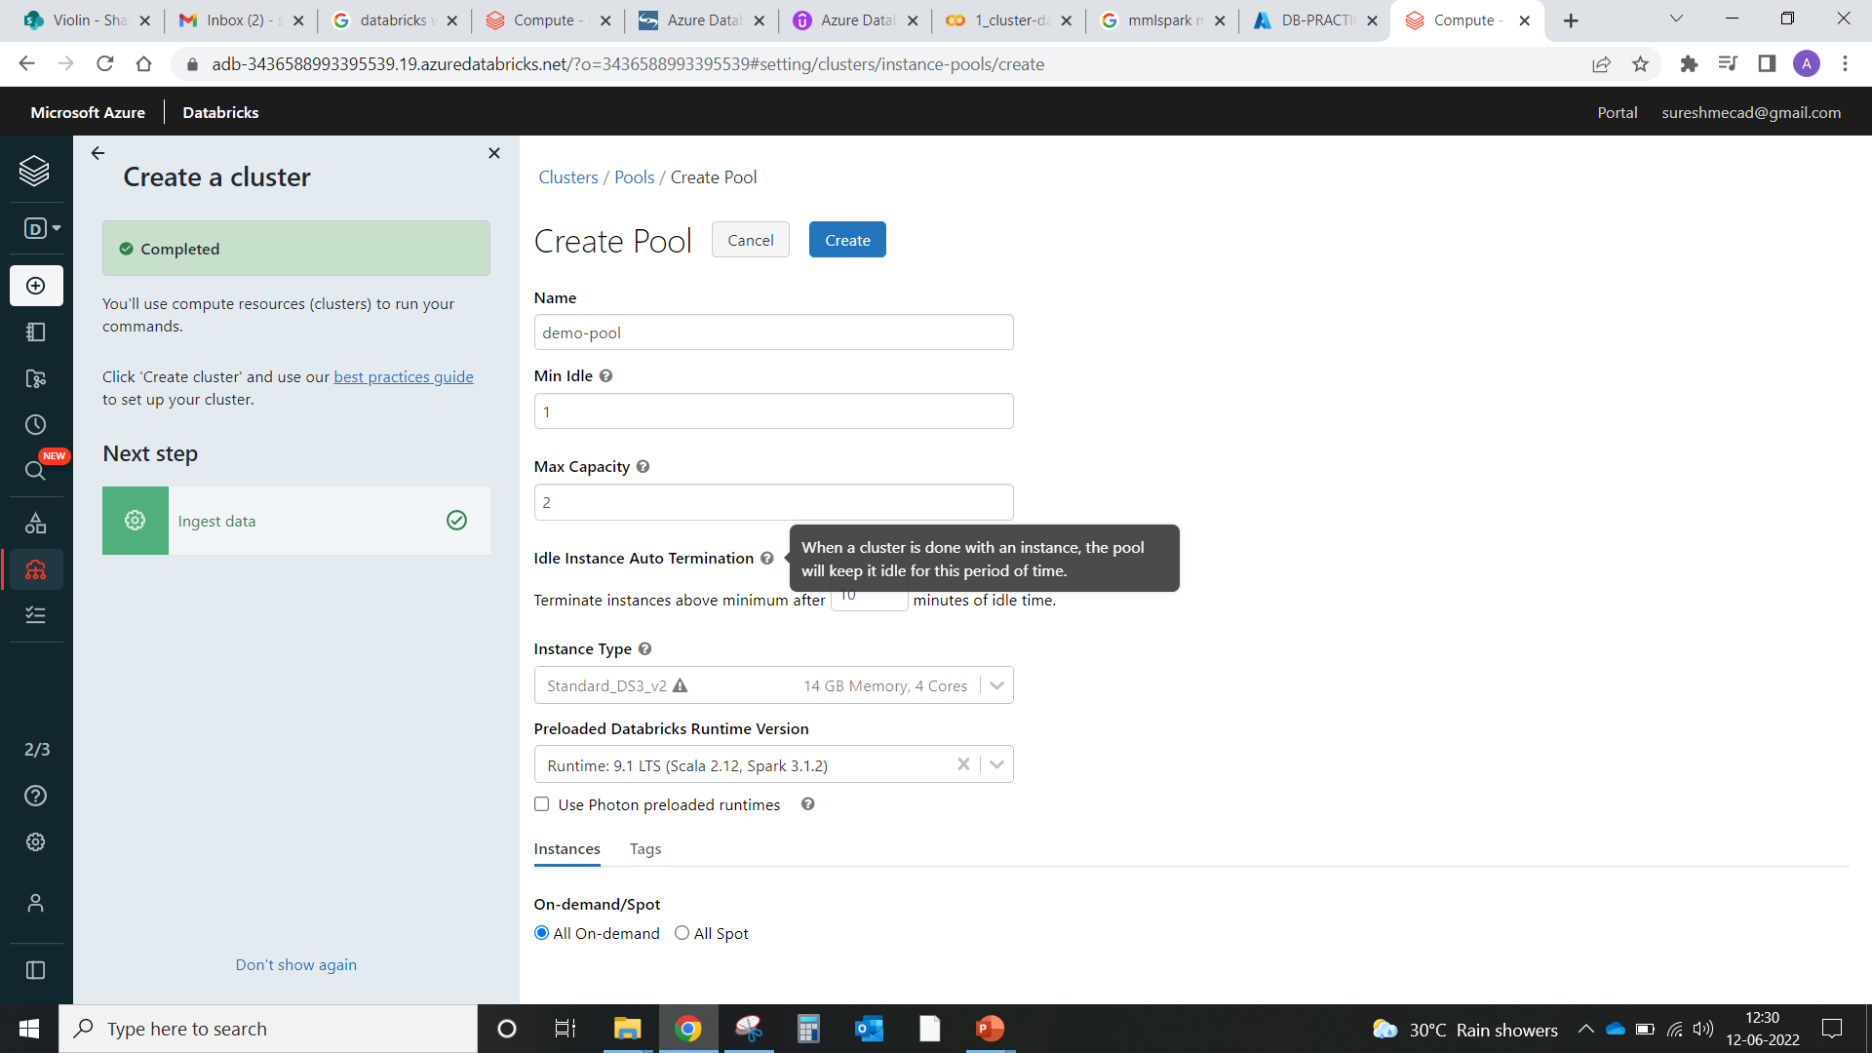

Slide 5
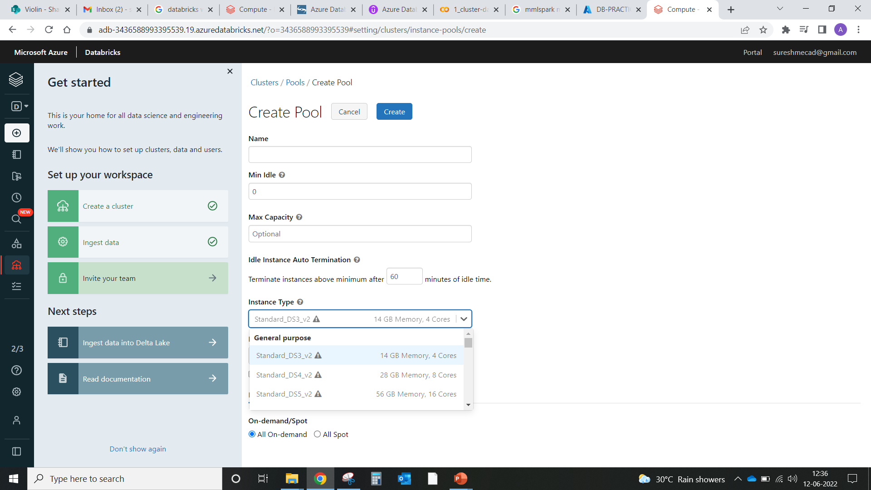







Slide 6
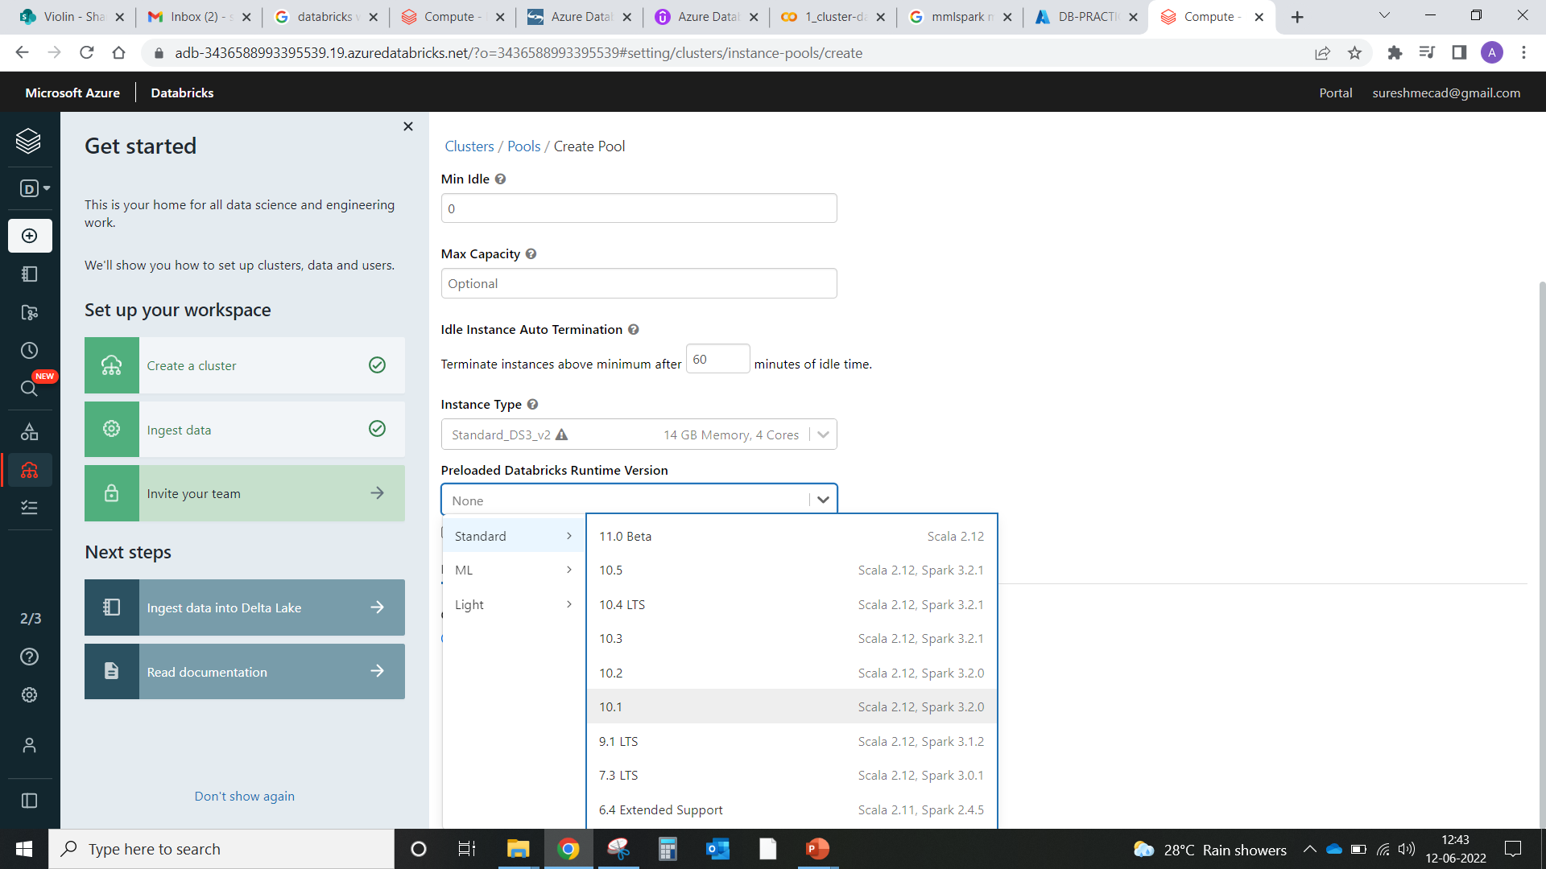

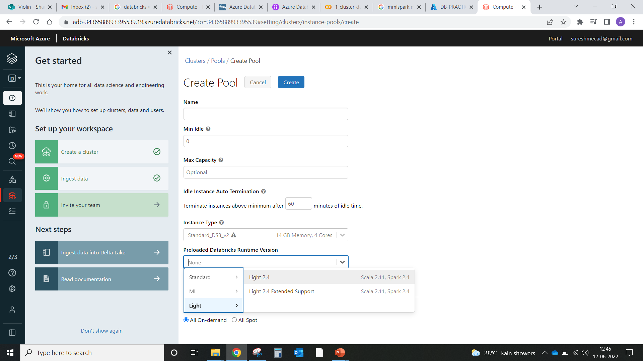

Slide 7
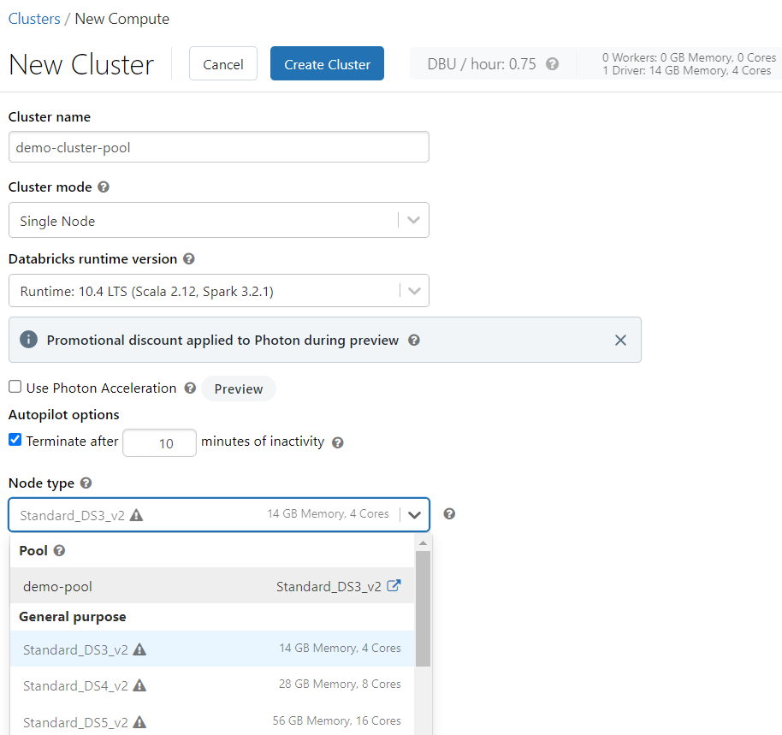

Slide 8
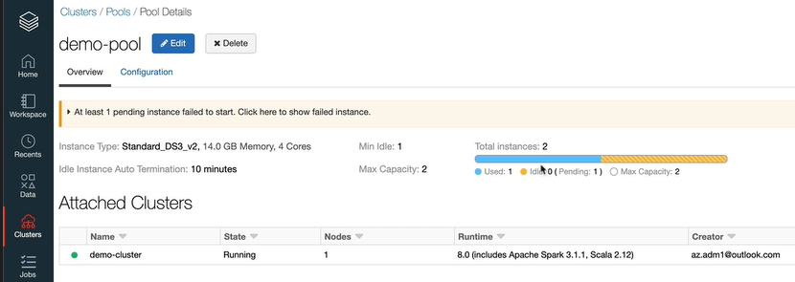

Slide 9
